Slide 1
FMD Framework
The FMD Framework enables organizations to streamline data operations by leveraging metadata to drive dynamic data pipelines and parameterized notebooks. Built on Fabric SQL Database, the framework supports secure, flexible, and modern data management at scale.

Slide 2
Workspace Type | Purpose | Examples
Data | Manage and store data | Data Landing Zone, Bronze, Silver,Gold,Semantic Model,DataFlows
Code | Develop and manage code artifacts | Data Pipelines, Notebooks, Spark Environment, Variable Library, Data Build Tools
Orchestration & logging | Orchestrate and monitor data operations | Fabric SQL Database, Auditing, Logging

Slide 3
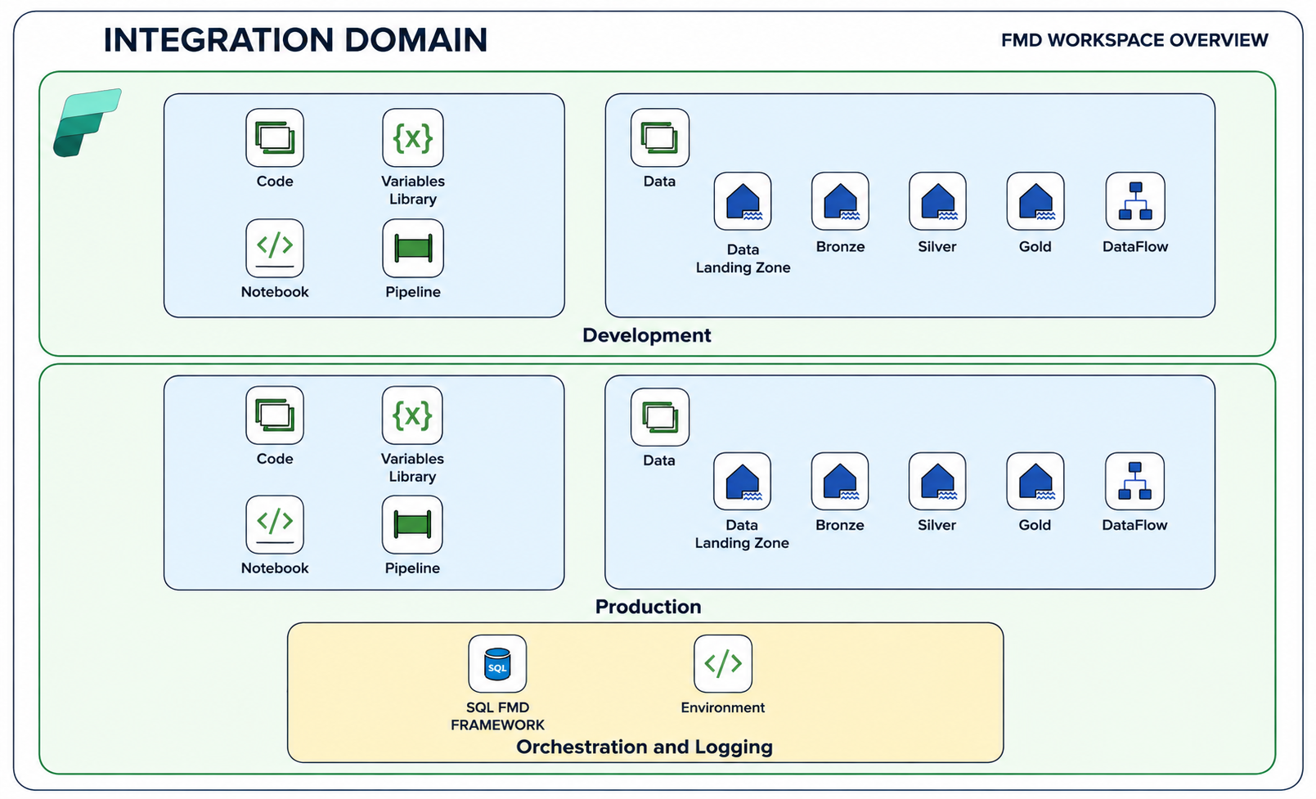

Slide 4
FMD Data Pipelines overview
LOAD_ALL
Coordinates the execution of the Landingzone, Bronze, and Silver pipelines. Use this pipeline to initiate a complete data load across all layers.
Parameters:
ConnectionString : ConnectionString of the Configuration Database (Automatically set during deployment)
Database name: Name of the Configuration Database (Automatically set during deployment)

Slide 5
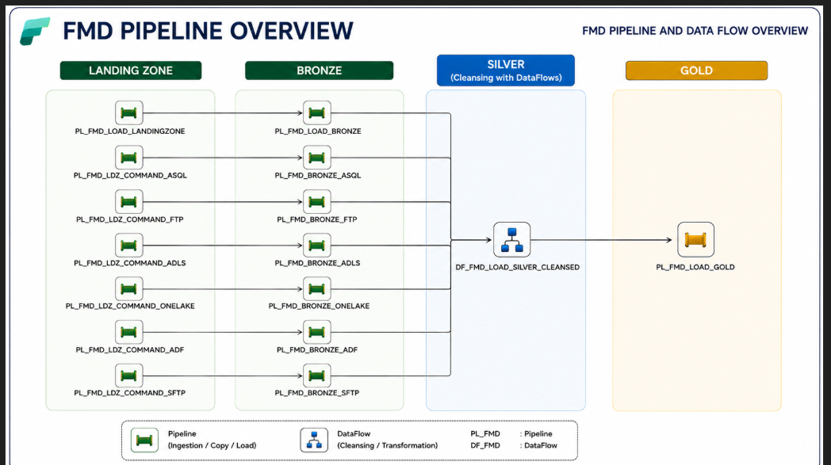

Slide 6
LOAD_LANDINGZONE
Determines which command pipeline to execute based on the supported connection types for the data Landingzone. Enables flexible integration with various data sources.

Slide 7
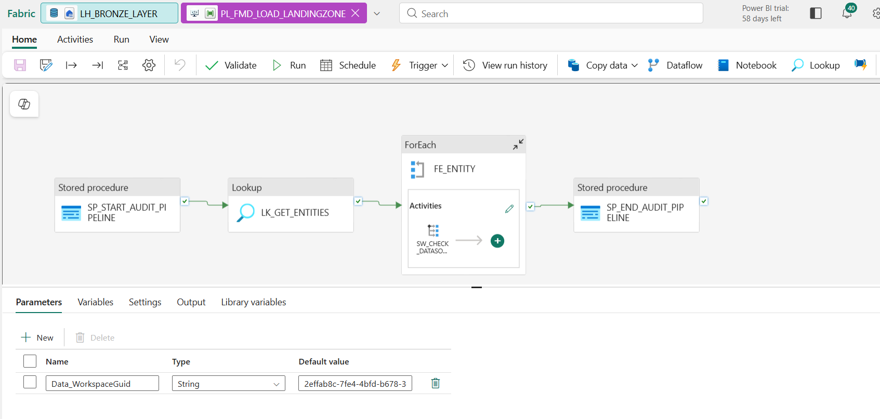

Slide 8
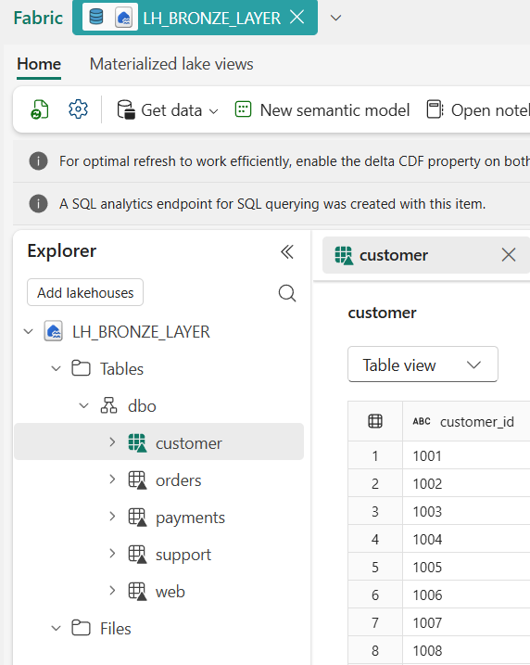
LOAD_BRONZE
Manages the execution of NB_FMD_LOAD_LANDING_BRONZE through NB_FMD_PROCESSING_PARALLEL_MAIN. This notebook receives all entities to be processed, handles parallel processing, and manages retries. The default timeout is set to 7200 seconds, with 2 retries.

Slide 9
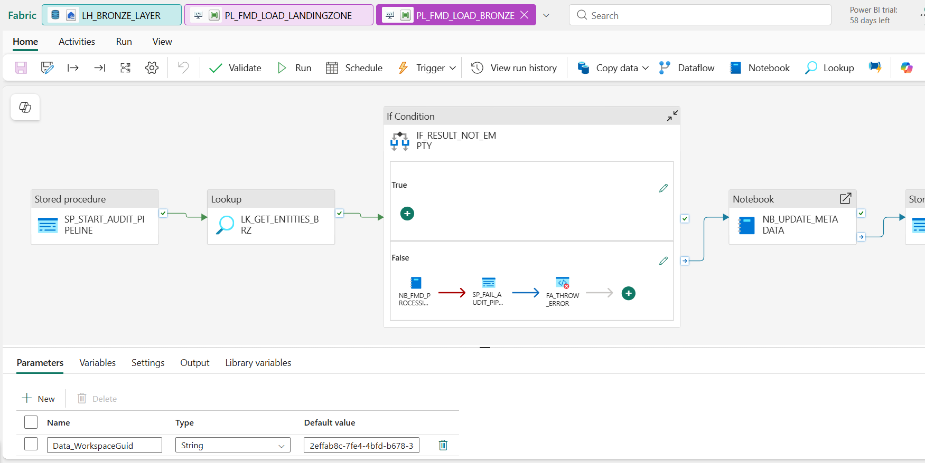

Slide 10
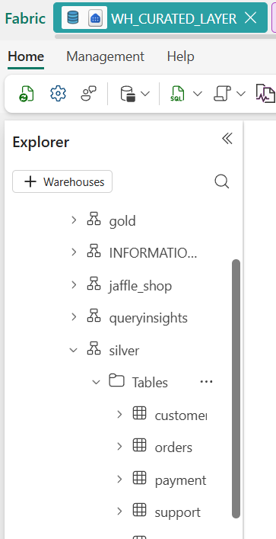
LOAD_SILVER
Manages the execution of NB_FMD_LOAD_BRONZE_SILVER through NB_FMD_PROCESSING_PARALLEL_MAIN and DataFLow different metadata for the Silver layer.
Load to WAREHOUSE WH_CURATED_LAYER having schema silver

Slide 11
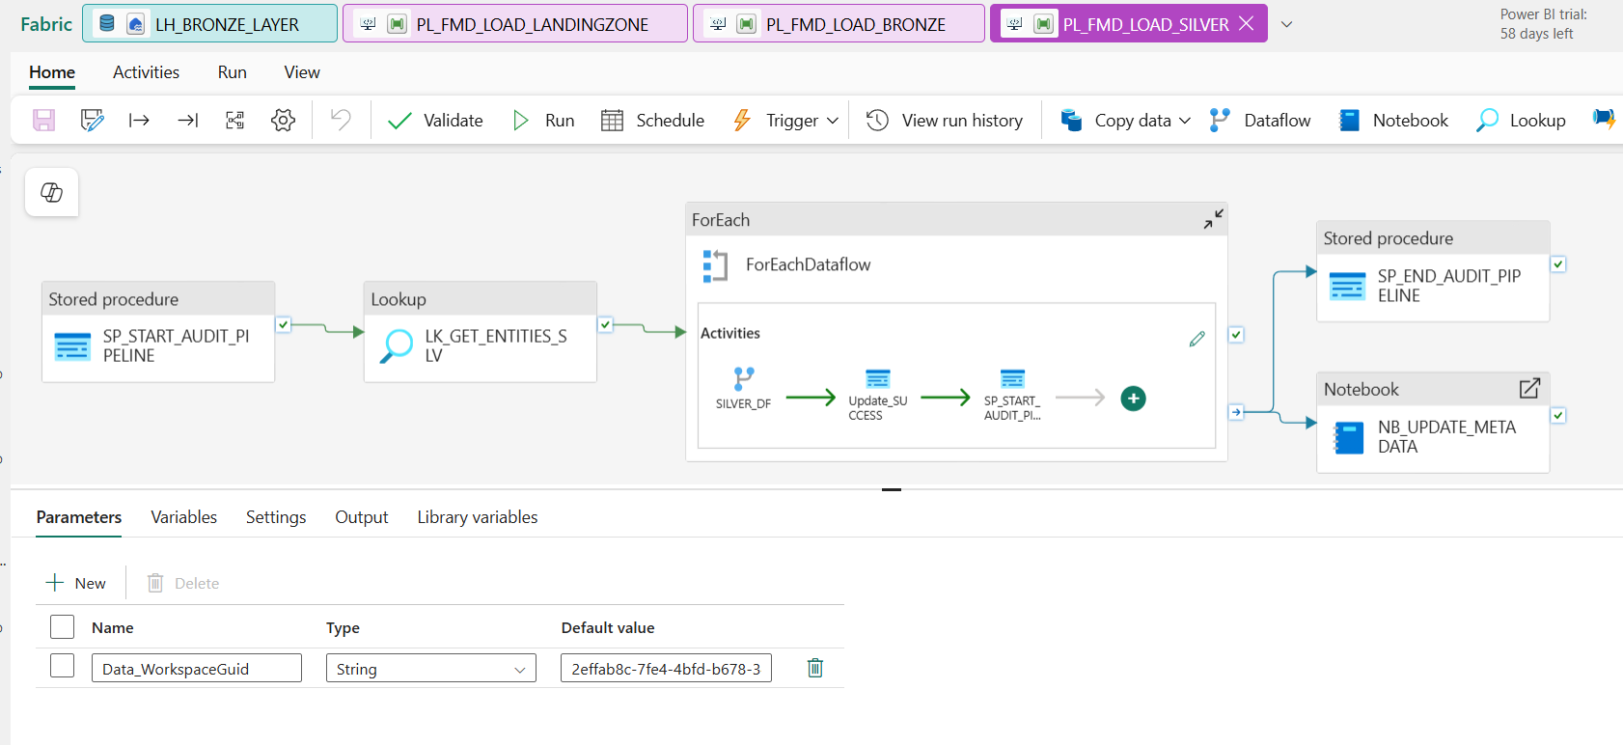

Slide 12
LOAD_GOLD
manages the execution of DataFlows through a parallel ForEach loop within the PL_FMD_LOAD_GOLD pipeline. Unlike the other layers, the Gold layer is driven by table-specific curated business logic, providing the flexibility to implement custom pipelines and transformations as required. Therefore, this layer cannot be fully generalized like the Landing, Bronze, or Silver layers.
The processed and curated data is finally loaded into the WH_CURATED_LAYER warehouse under the gold schema.

Slide 13
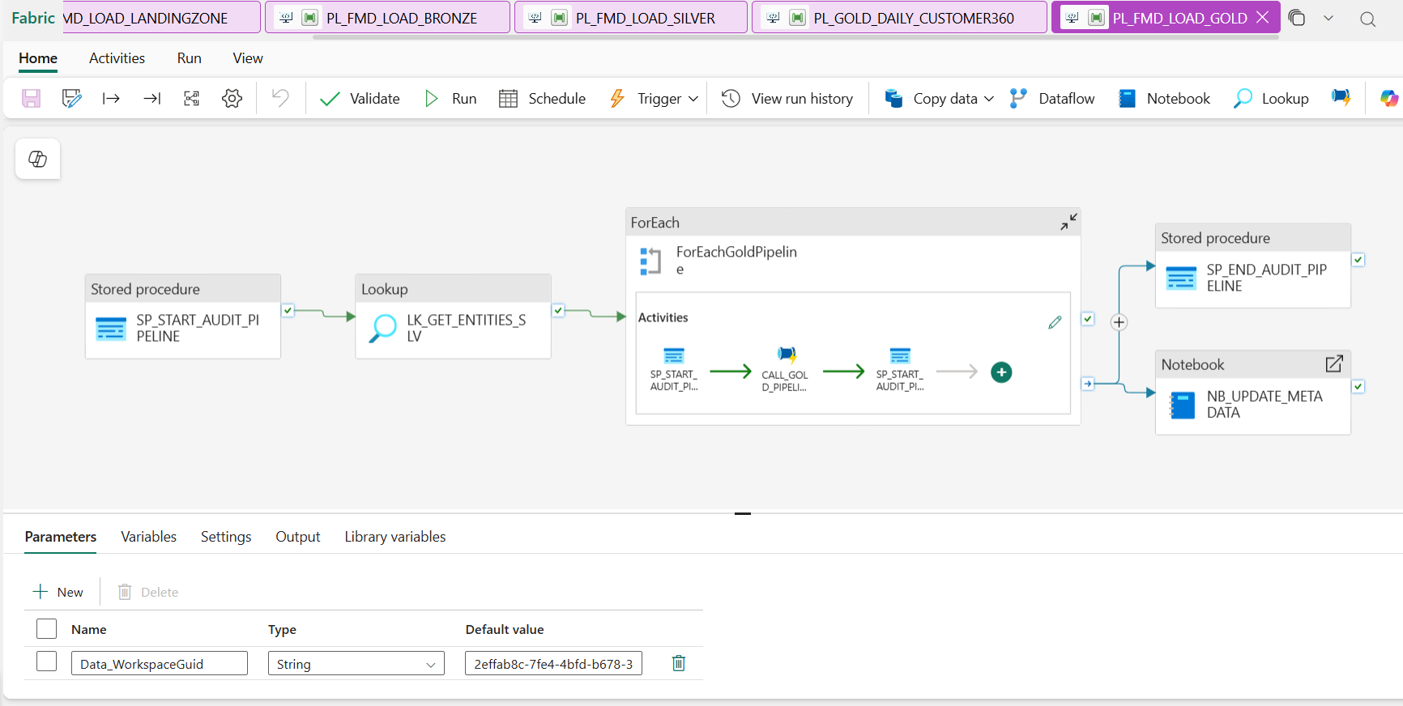

Slide 14
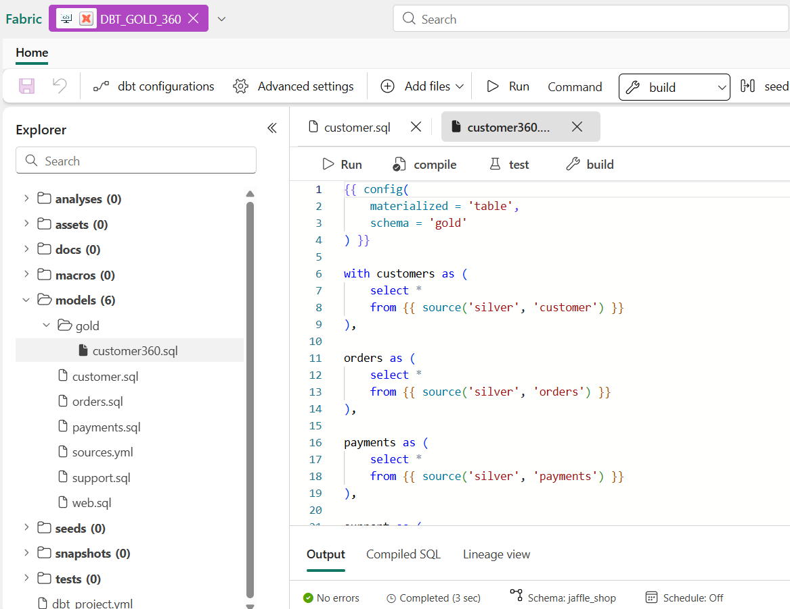
DBT JOB-> Silver->Gold

Slide 15
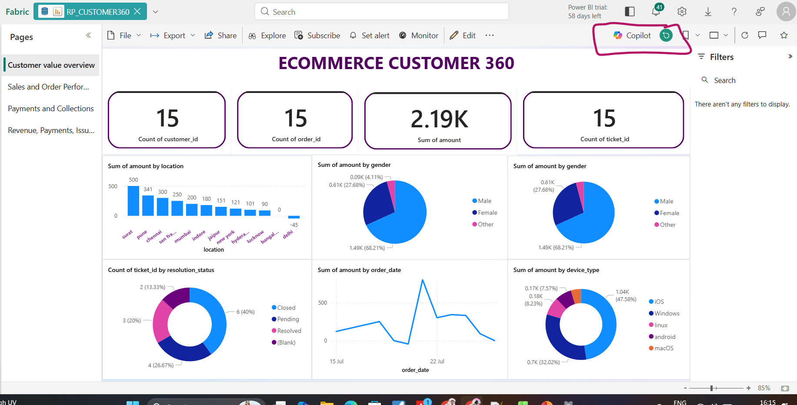
MODEL Report

Slide 16
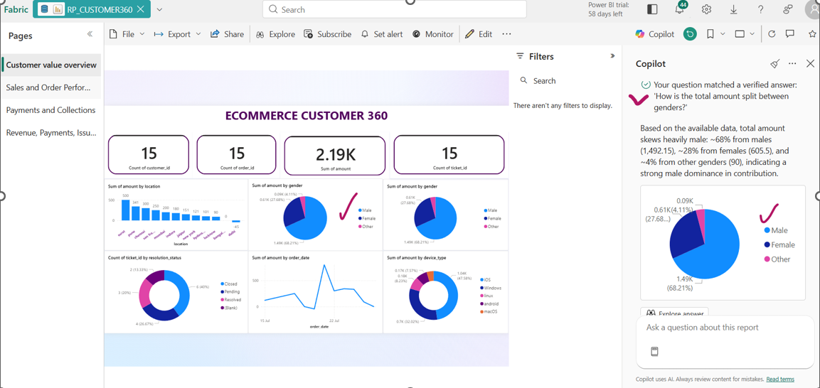

Slide 17
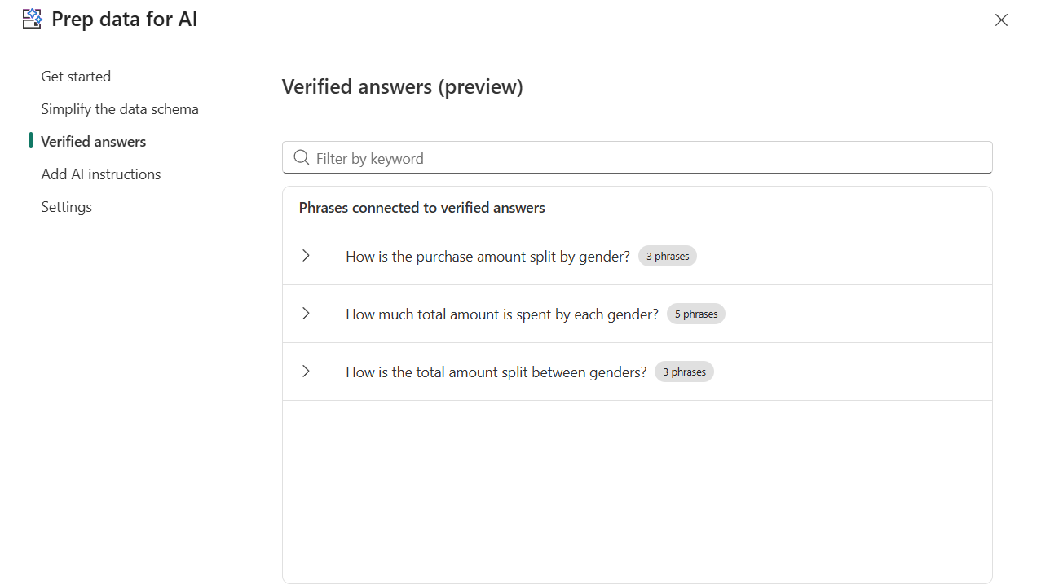

Slide 18
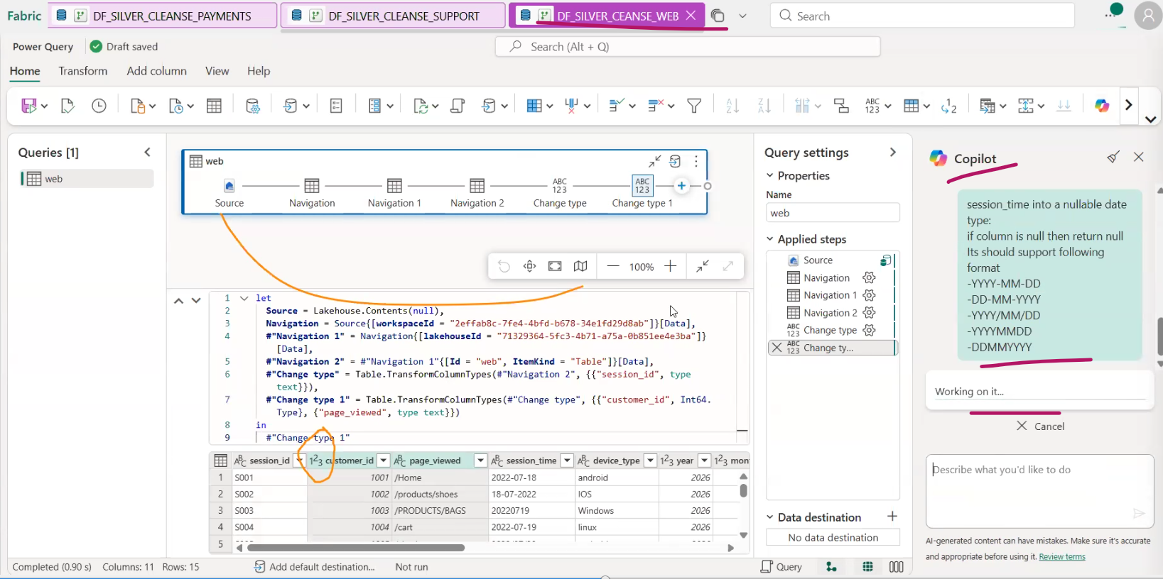
Copilot Assisted Transformation in DF

Slide 19
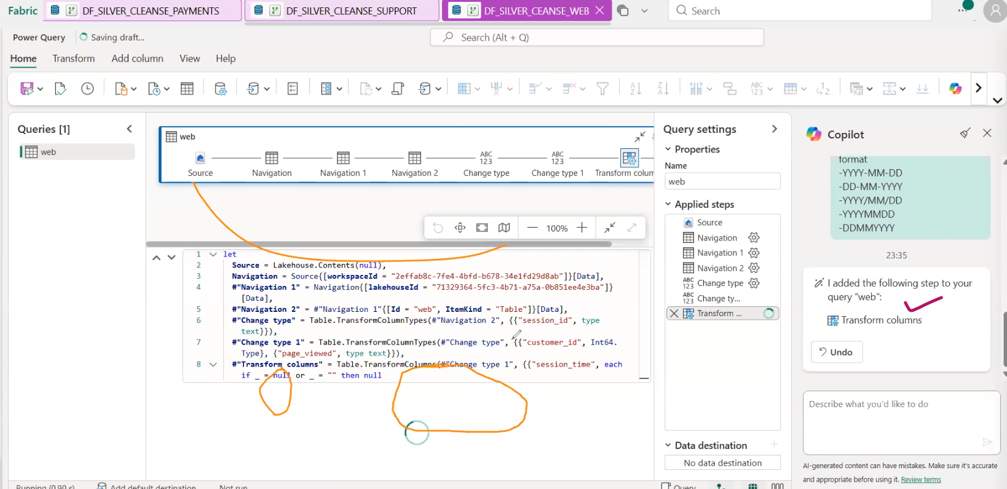

Slide 20
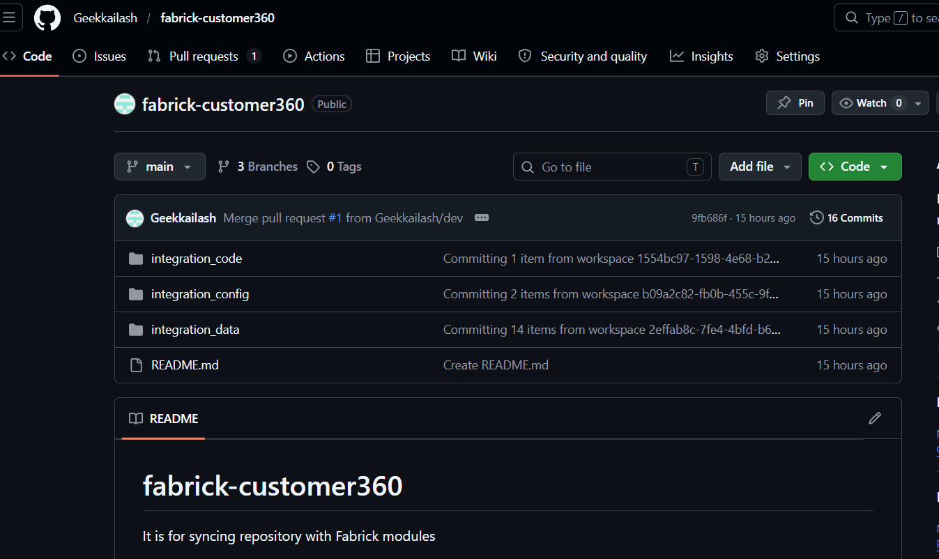
GITHUB
https://github.com/Geekkailash/fabrick-customer360

